Slide 1
SAM simétrico y asimétrico
Elio Campitelli

Slide 2
Introduction

Slide 3
Methods

Slide 4
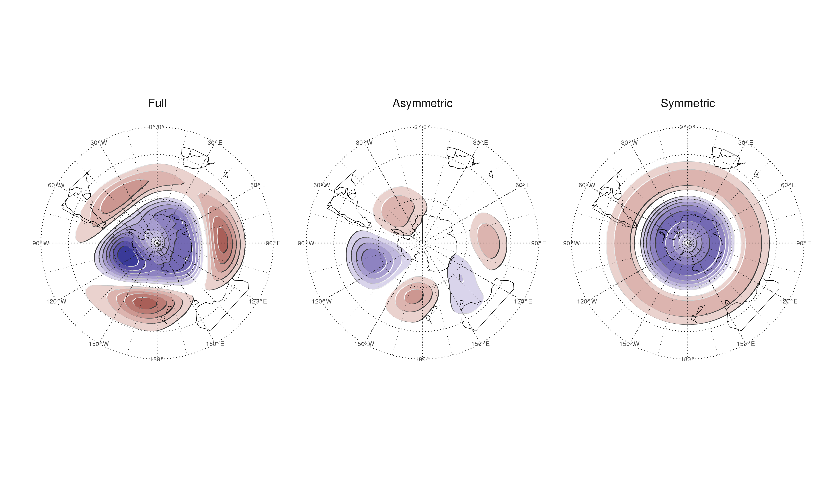
Spatial patterns of the first EOF of 700 hPa geopotential height. Full field (left), zonally asymmetric component (middle) and zonally symmetric component (right). Arbitrary units.

Slide 5
Results

Slide 6
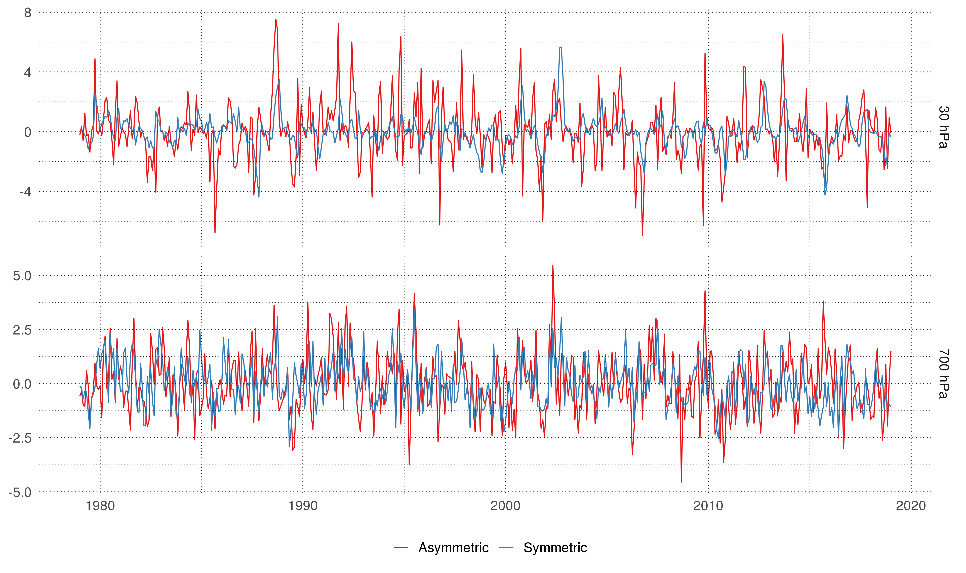
Time series for the asymmetric SAM and symmetric SAM.

Slide 7
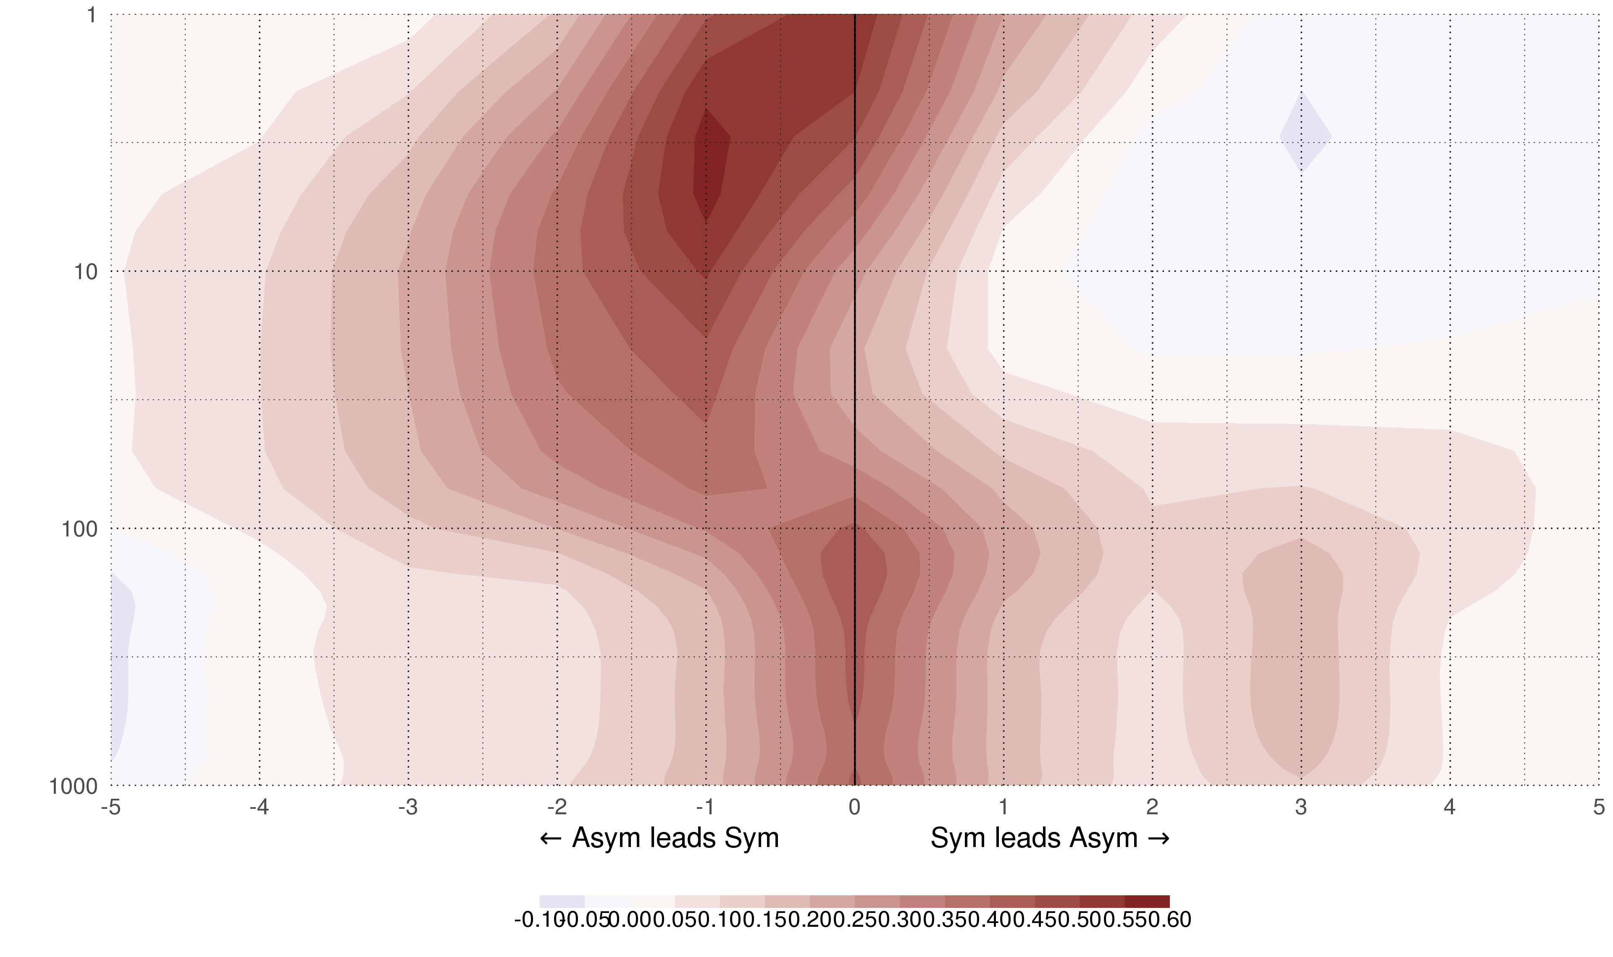
Lag-correlation between Symmetric and Asymmetric SAM at each level.

Slide 8
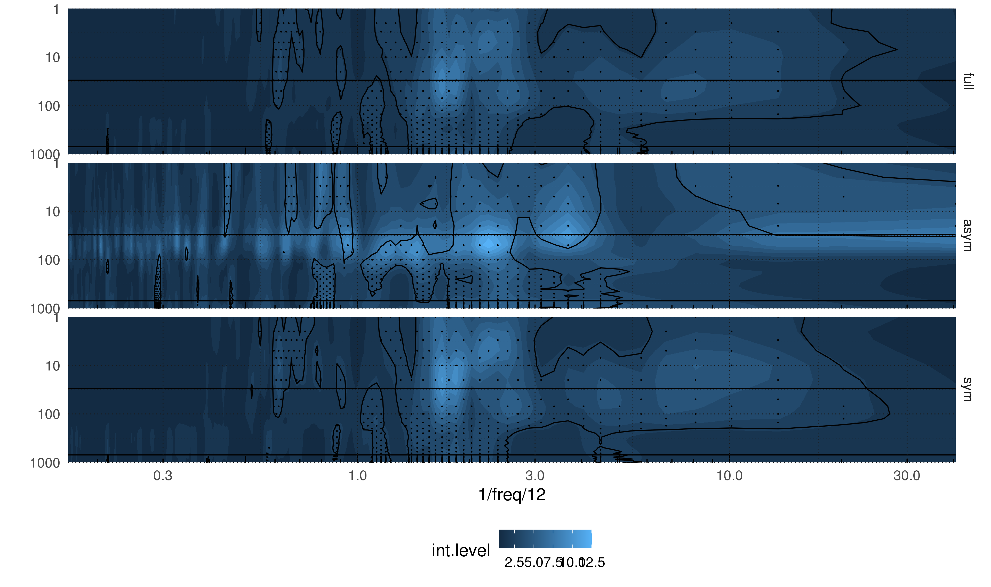

Slide 9
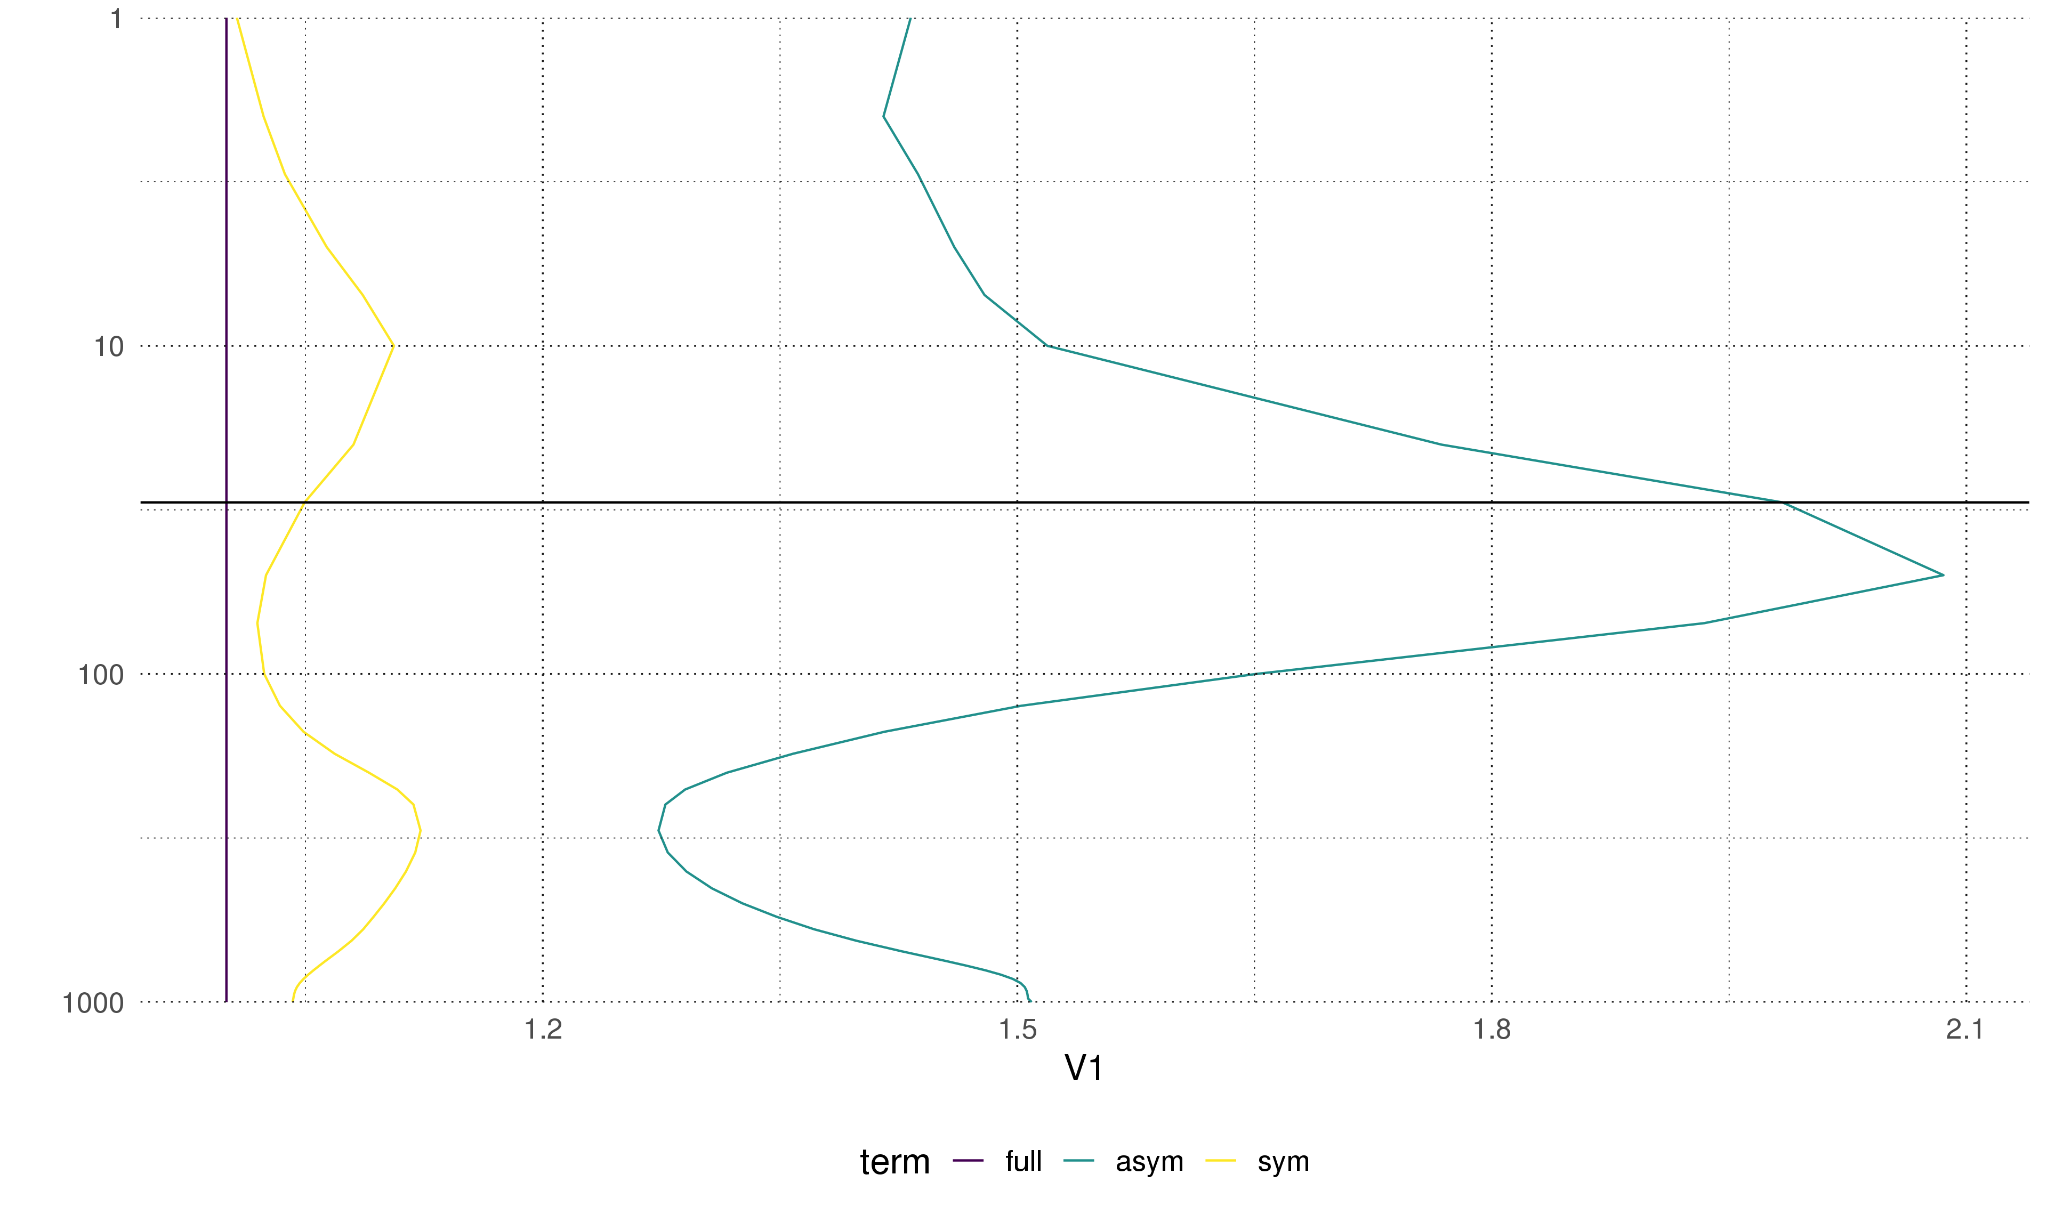

Slide 10
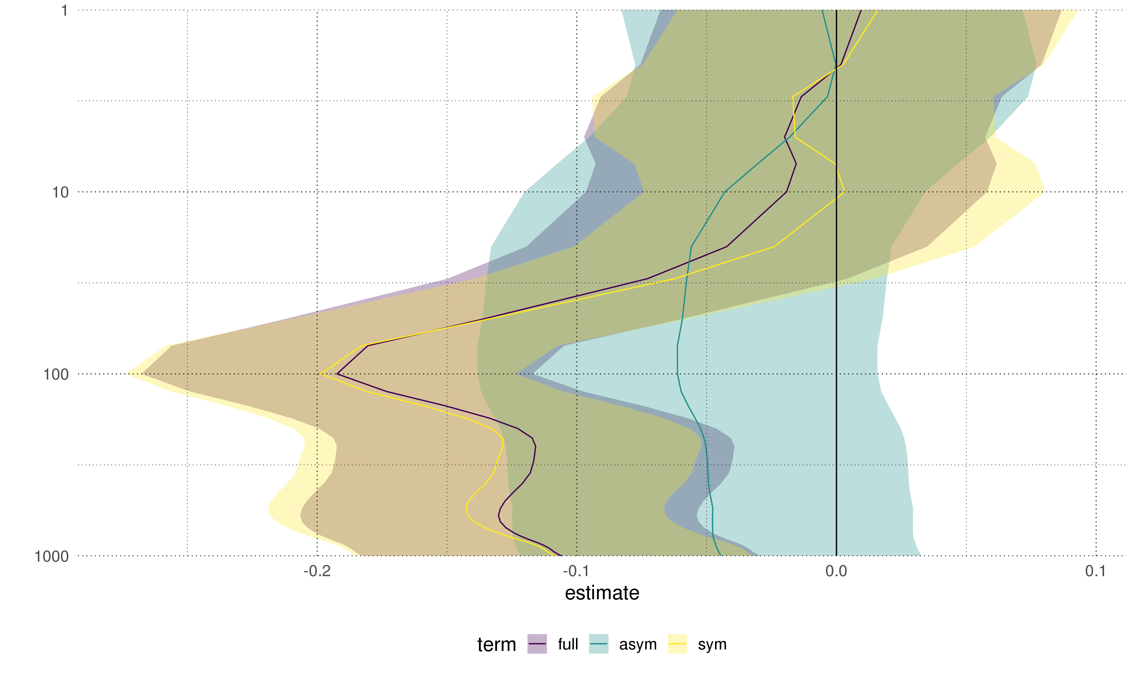
Trends (in standard deviations per decade) for each index at each level. Shading indicates the 95% confidence interval.

Slide 11
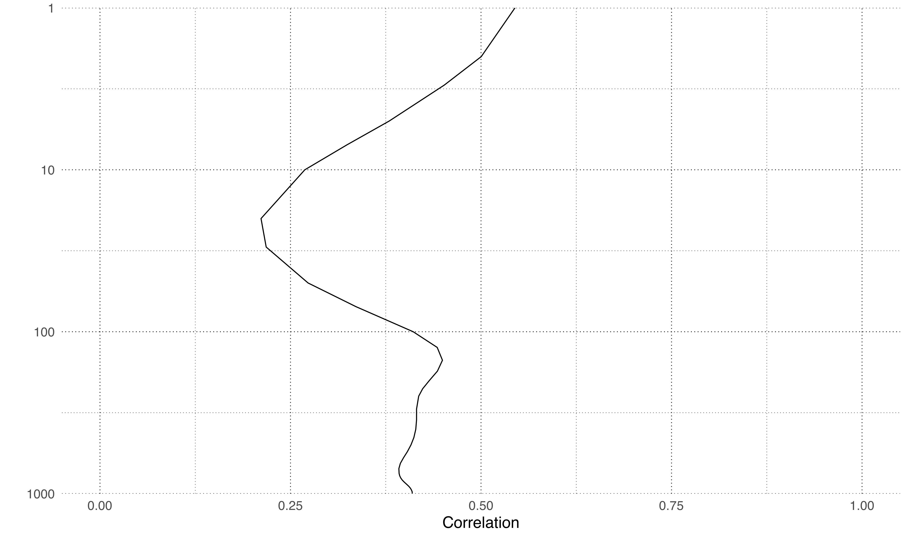
Correlation between the Symmetric and Asymmetric SAM at each level.

Slide 12
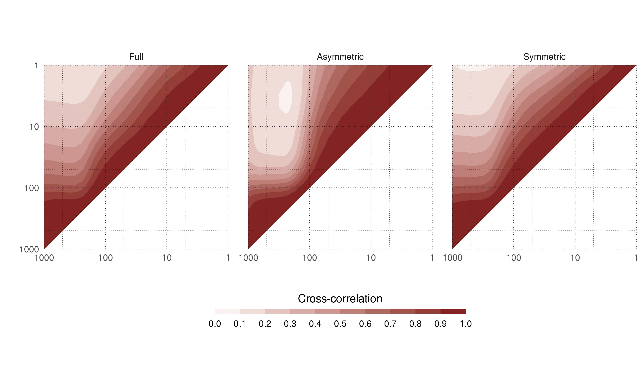
Cross correlation between levels of the Full, Asymmetric and Symmetric SAM.

Slide 13
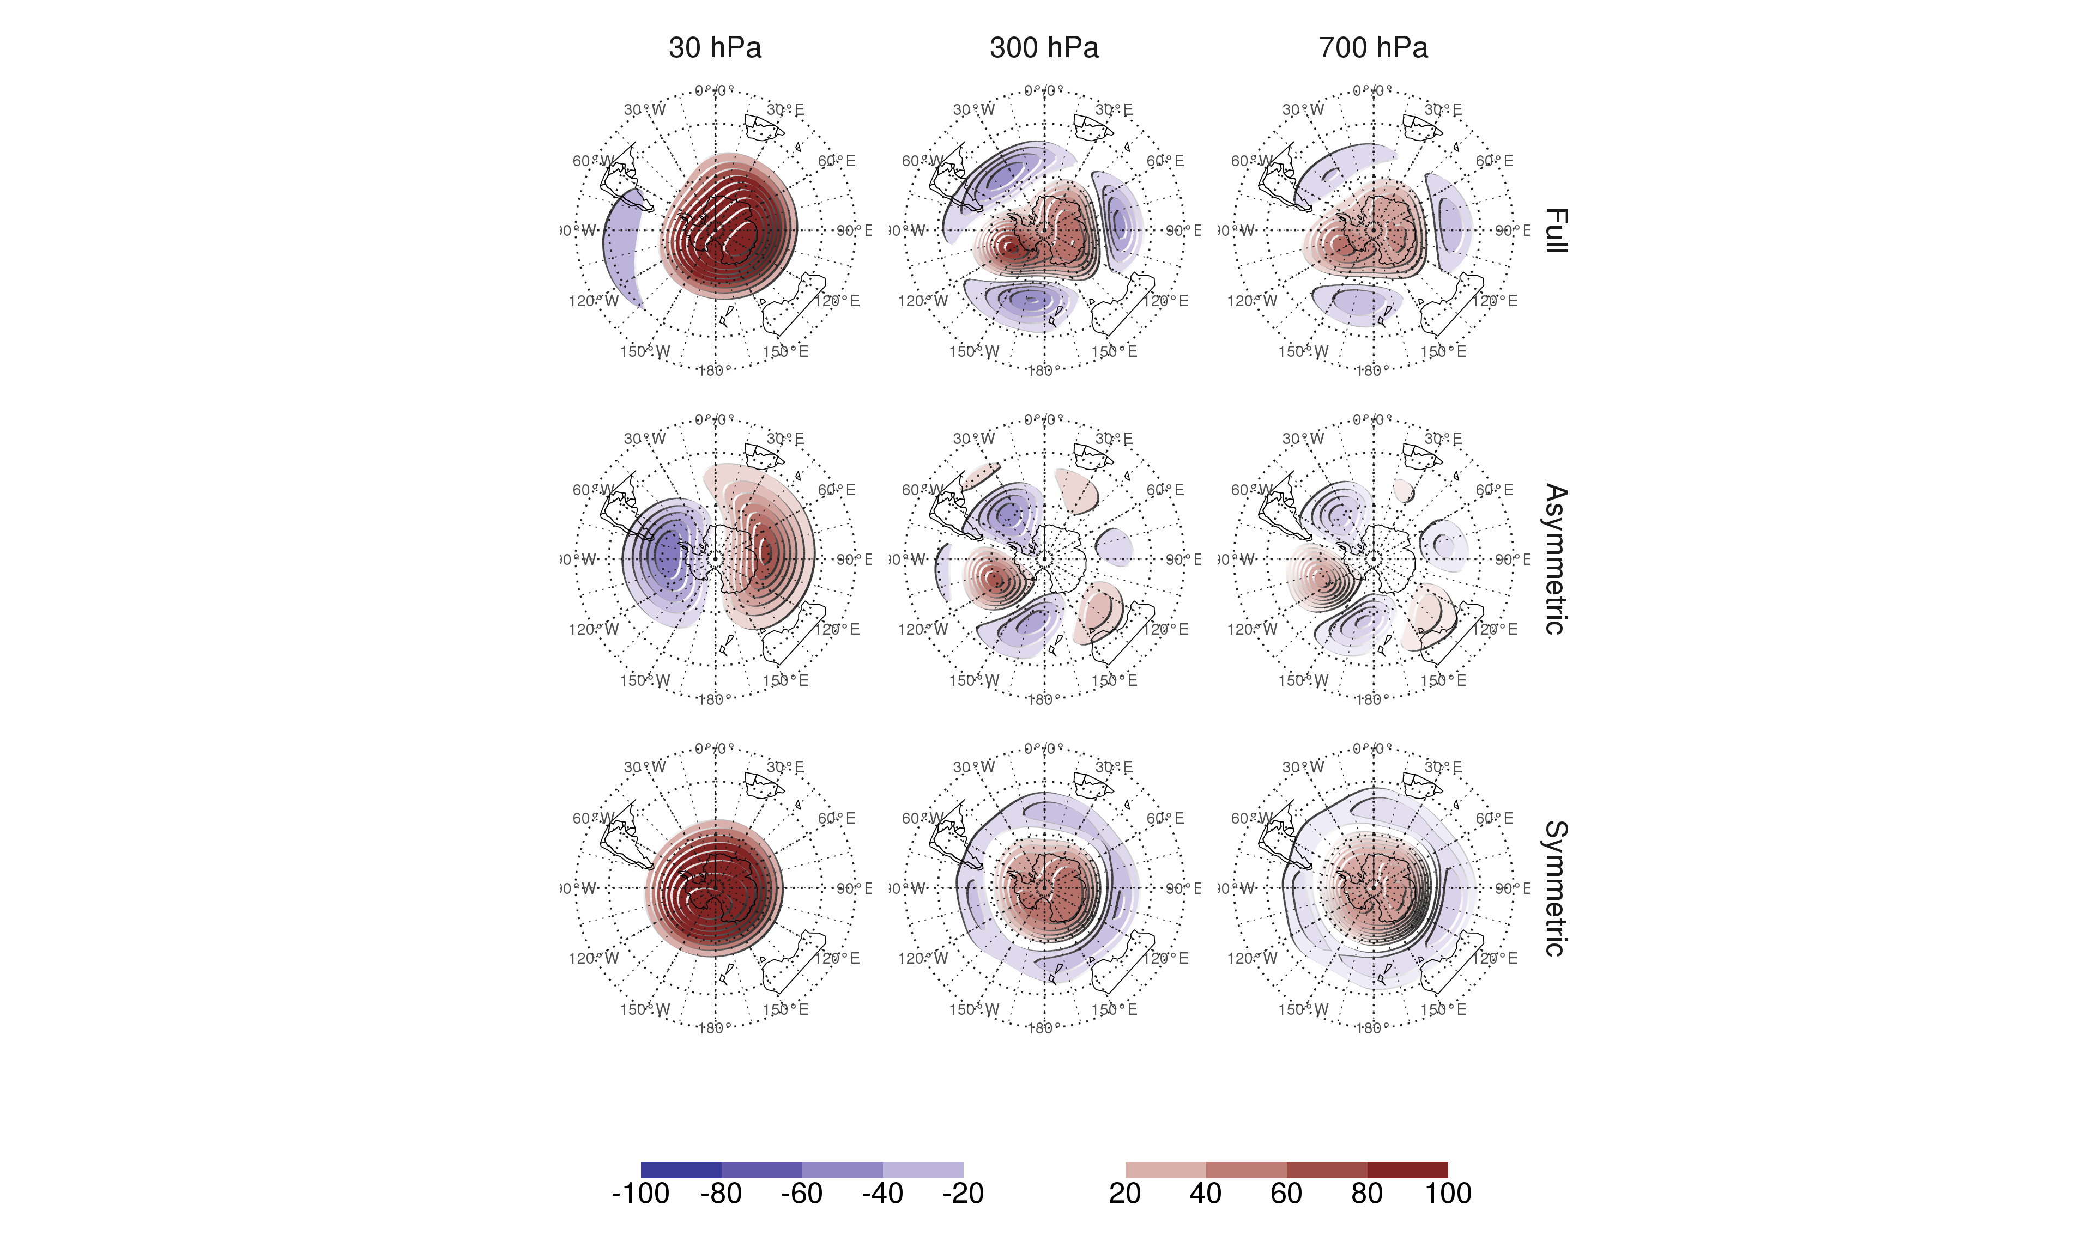
Regression patterns of geopotential height at 30, 300 and 700 hPa with the Full, Asymmetric and Symmetric SAM. The regression patterns for Asymmetric and Symmetric SAM are the result of one multiple regression using both indices, not of two simple regressions involving each index by itsef.

Slide 14
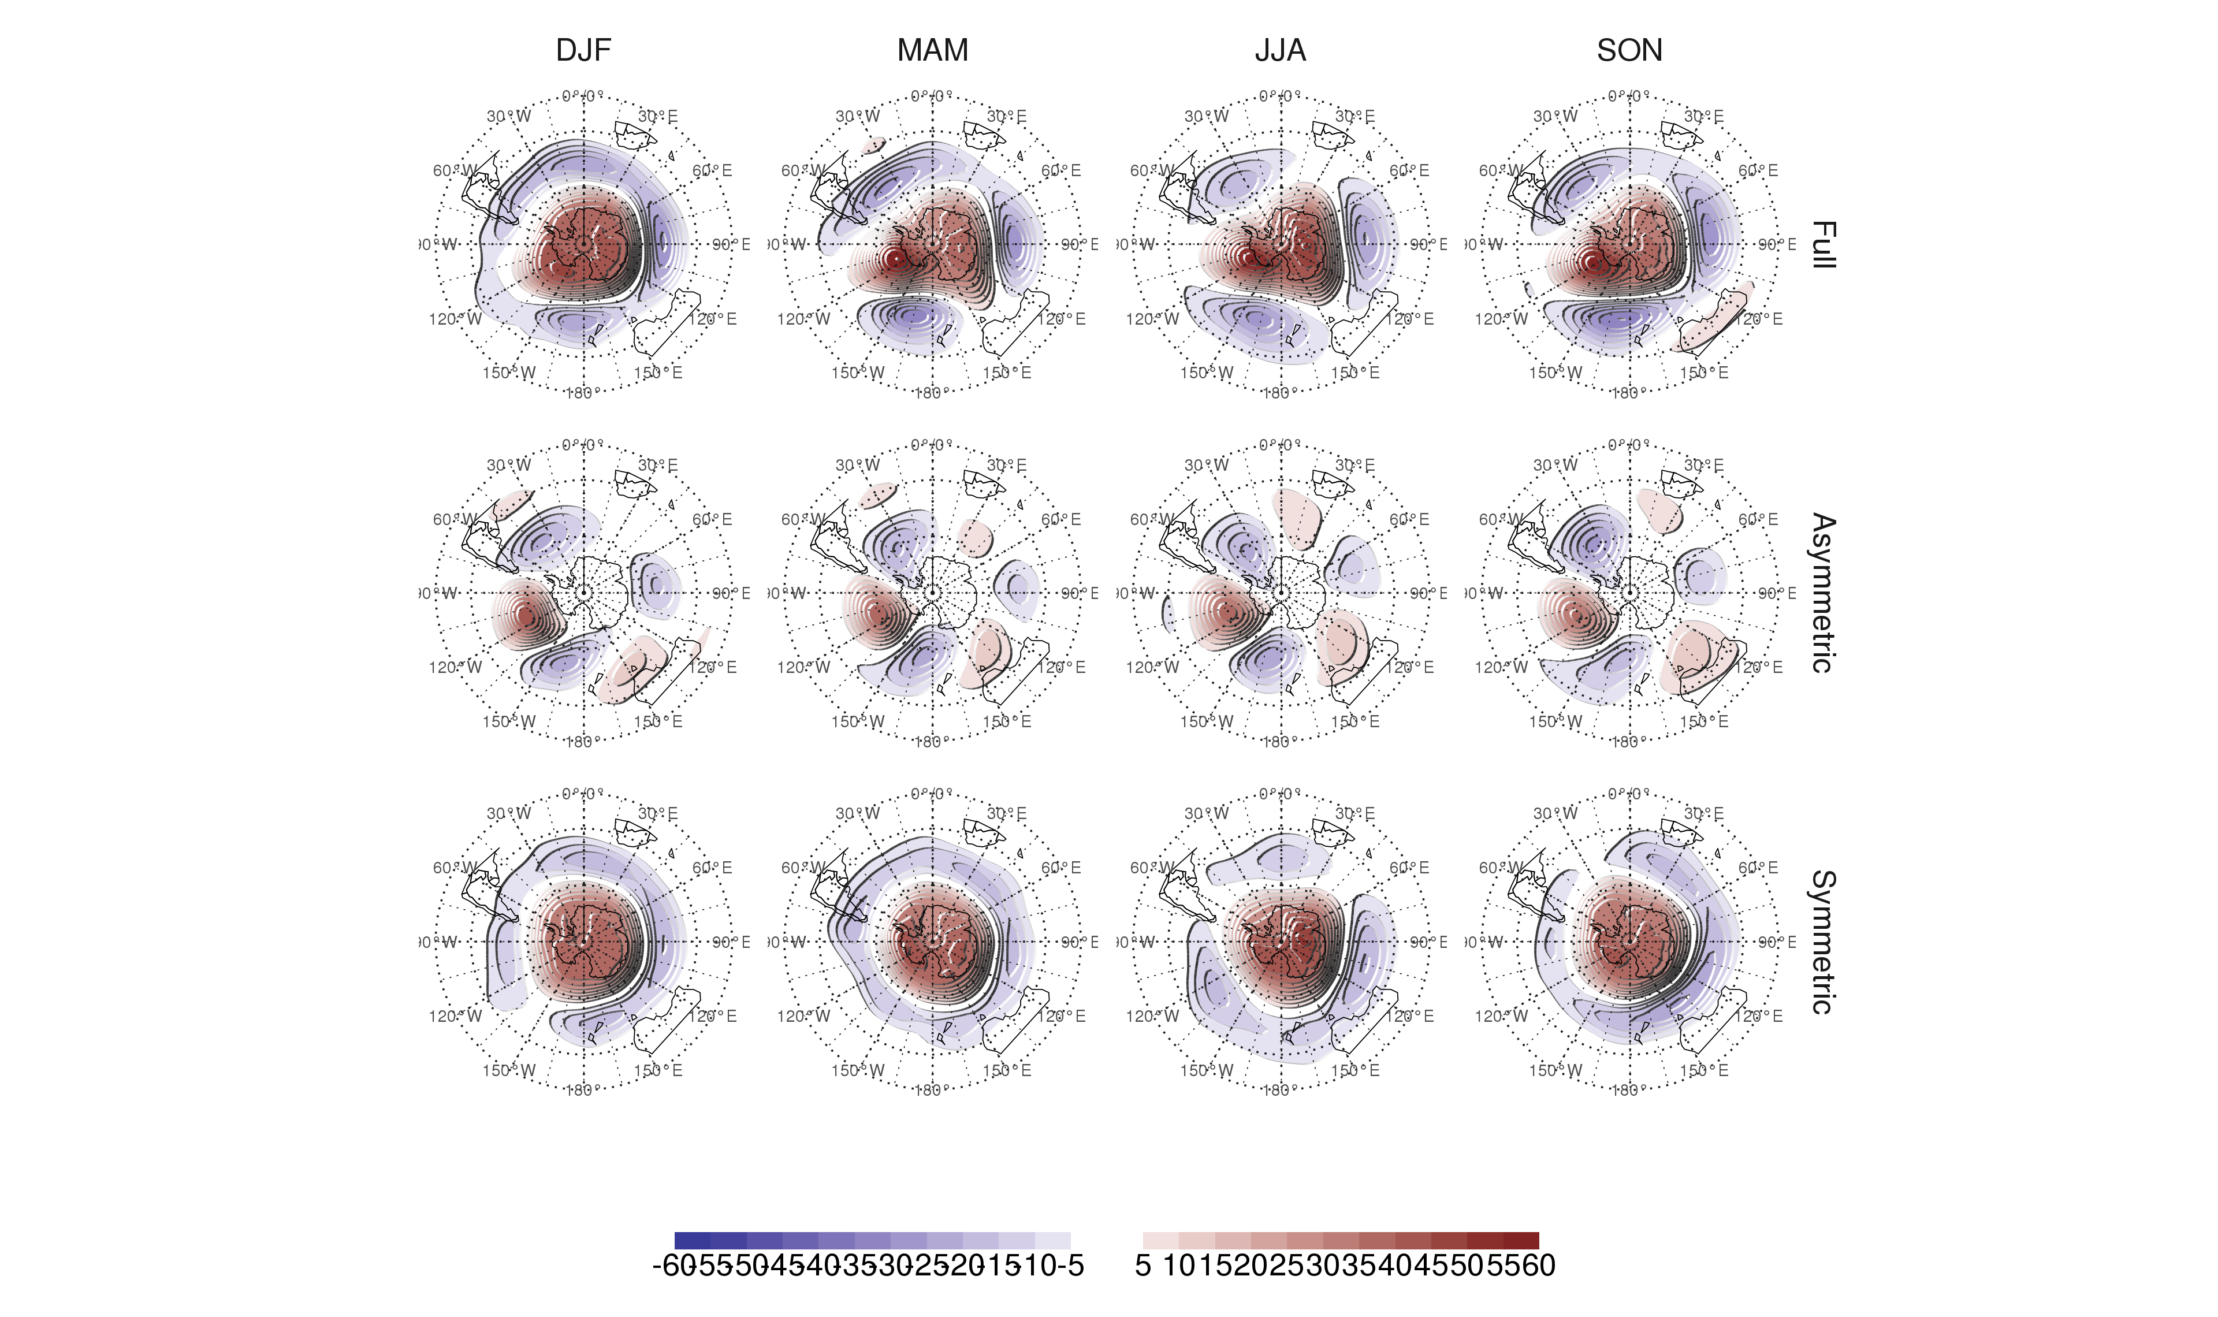
Seasonal regression patterns of geopotential height at 700 hPa with the Full, Asymmetric and Symmetric SAM. The regression patterns for Asymmetric and Symmetric SAM are the result of one multiple regression using both indices, not of two simple regressions involving each index by itsef.

Slide 15
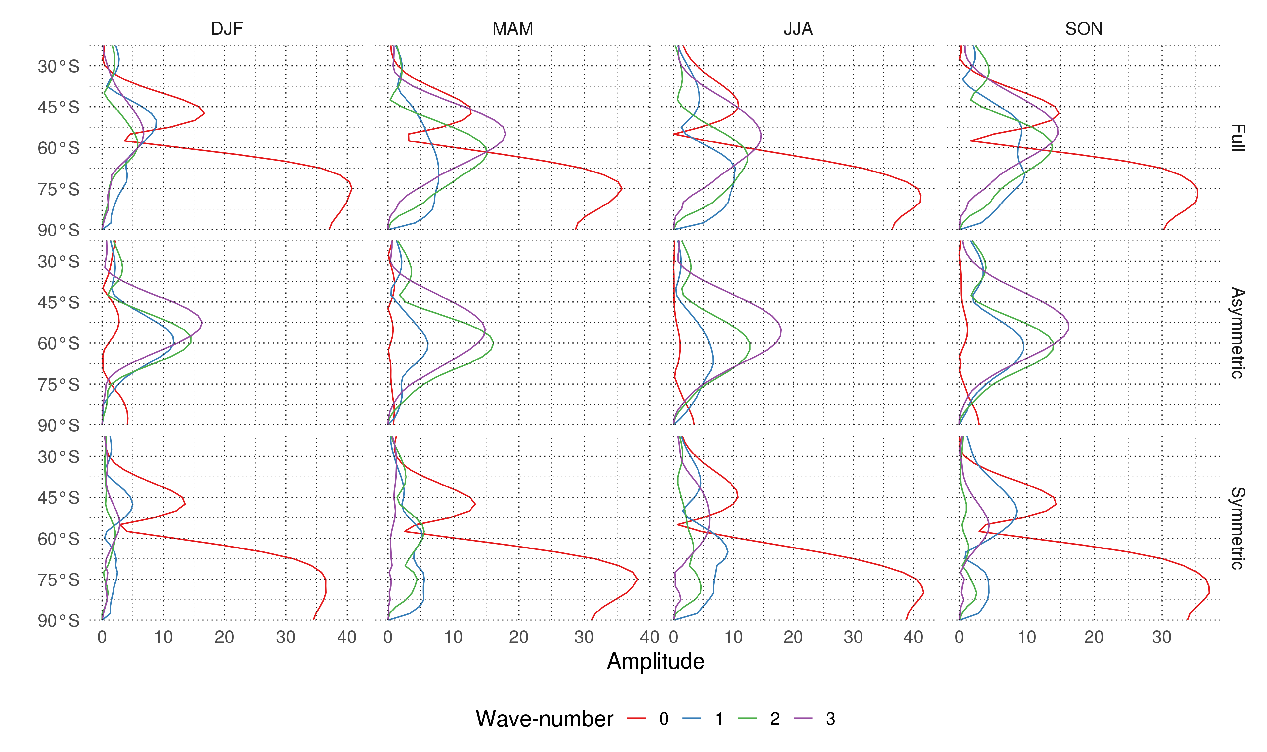
Planteray wave amplitude for the regression patterns at 700 hPa.

Slide 16
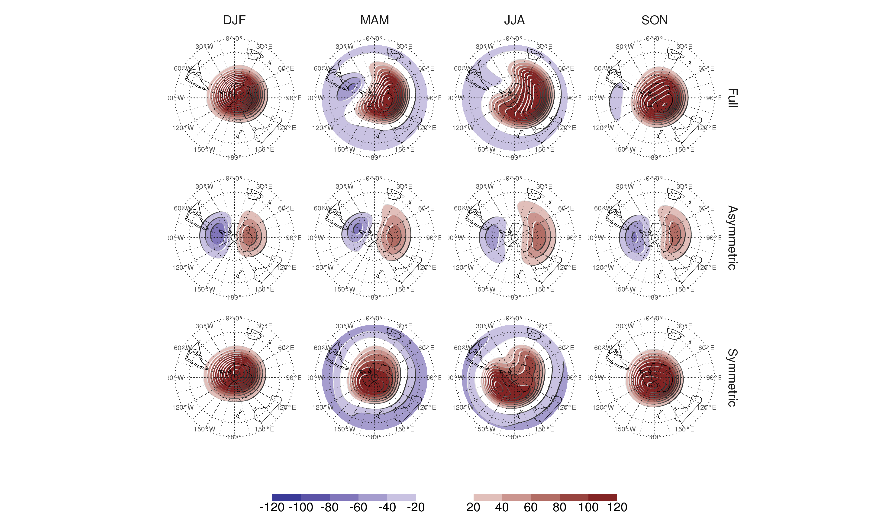
Seasonal regression patterns of geopotential height at 30 hPa with the Full, Asymmetric and Symmetric SAM. The regression patterns for Asymmetric and Symmetric SAM are the result of one multiple regression using both indices, not of two simple regressions involving each index by itsef.

Slide 17
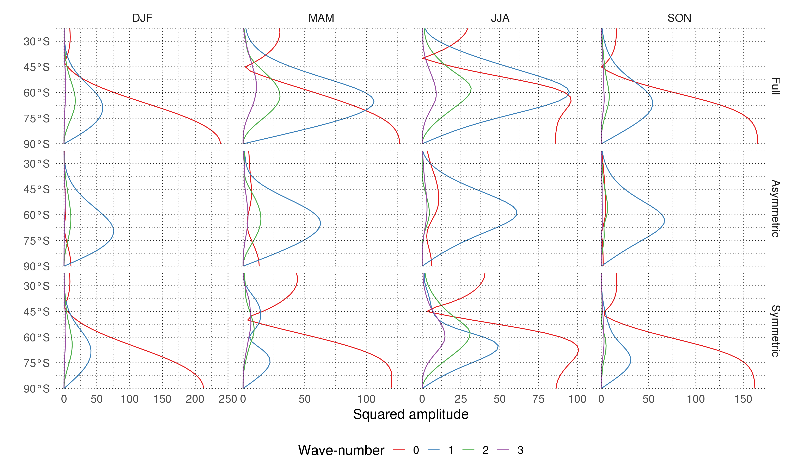
Planteray wave amplitude for the regression patterns at 30 hPa.

Slide 18
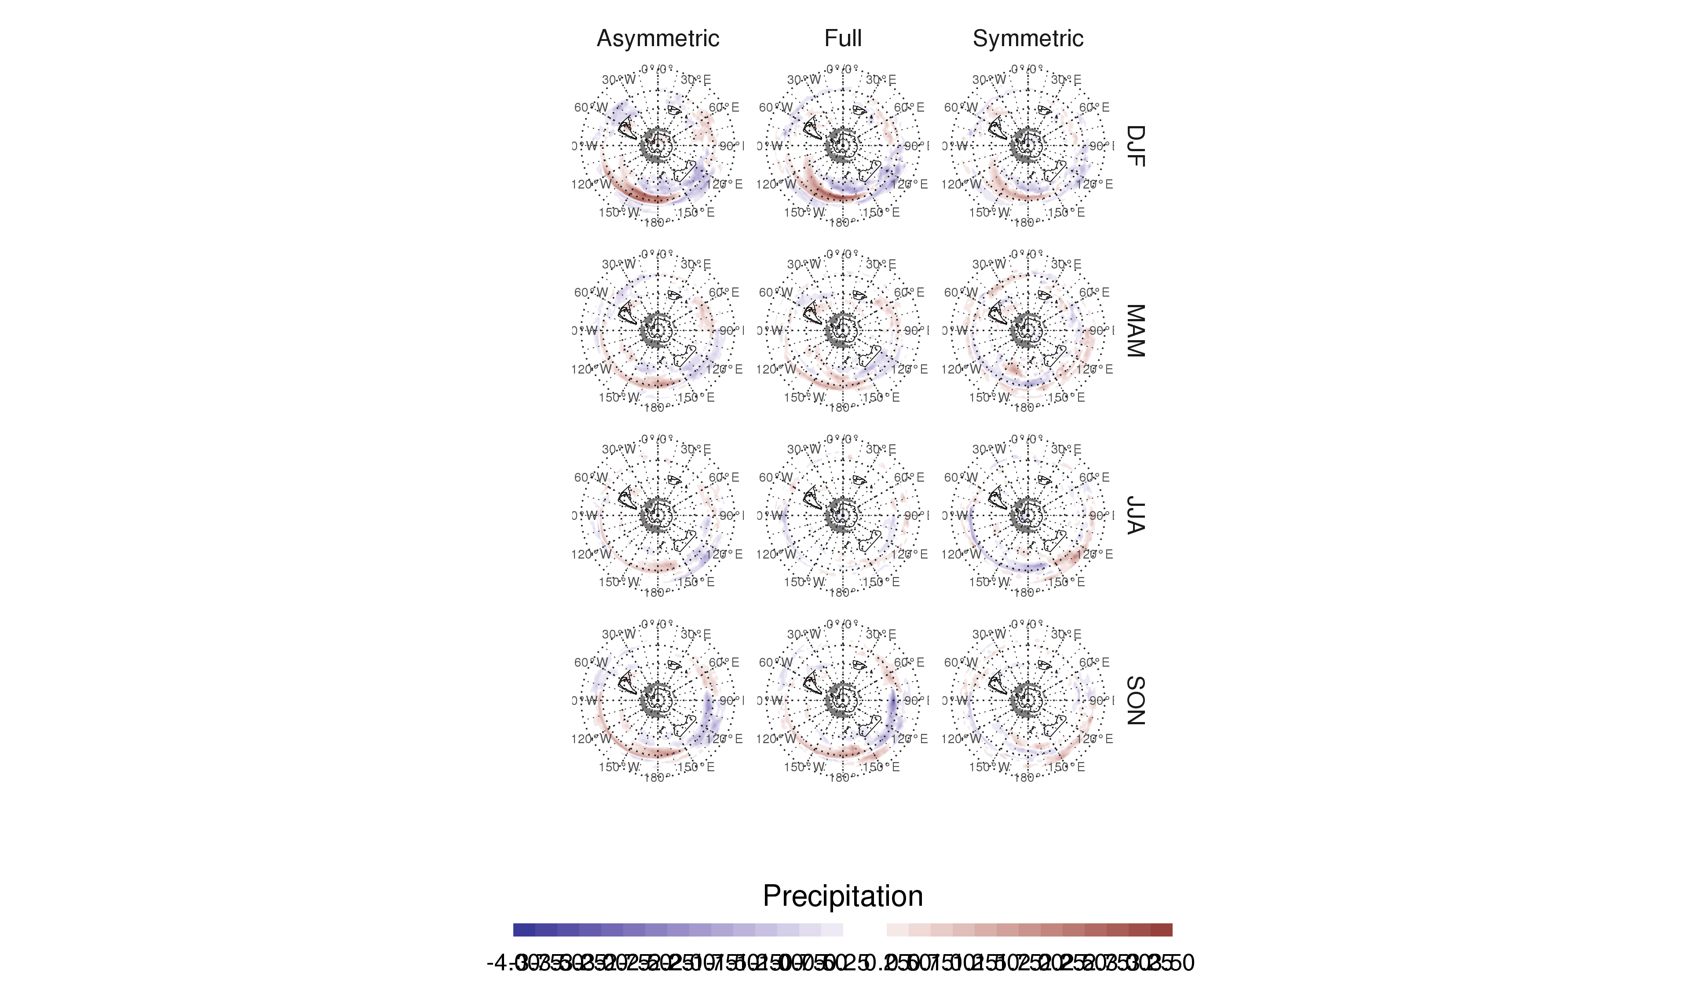

Slide 19
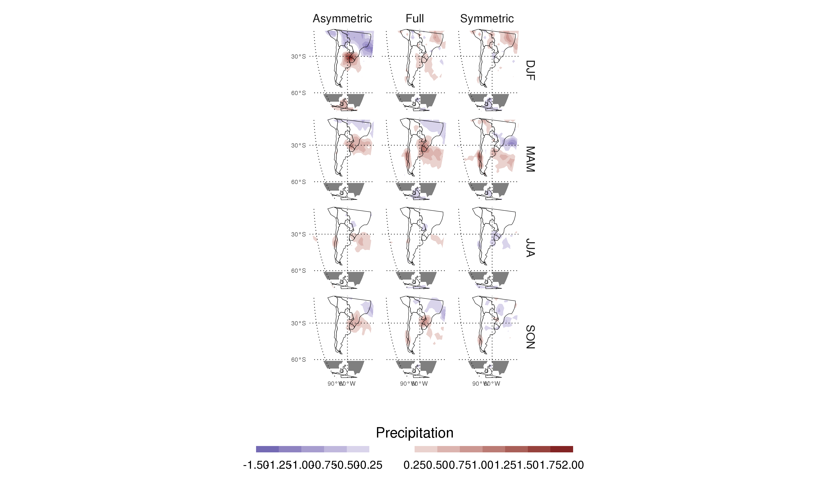
Regression pattern of precipiation with Asymmetric and Symmetric SAM. P-values smaller than 0.05 (controlling for Flase Detection Rate) as hatched areas.

Slide 20
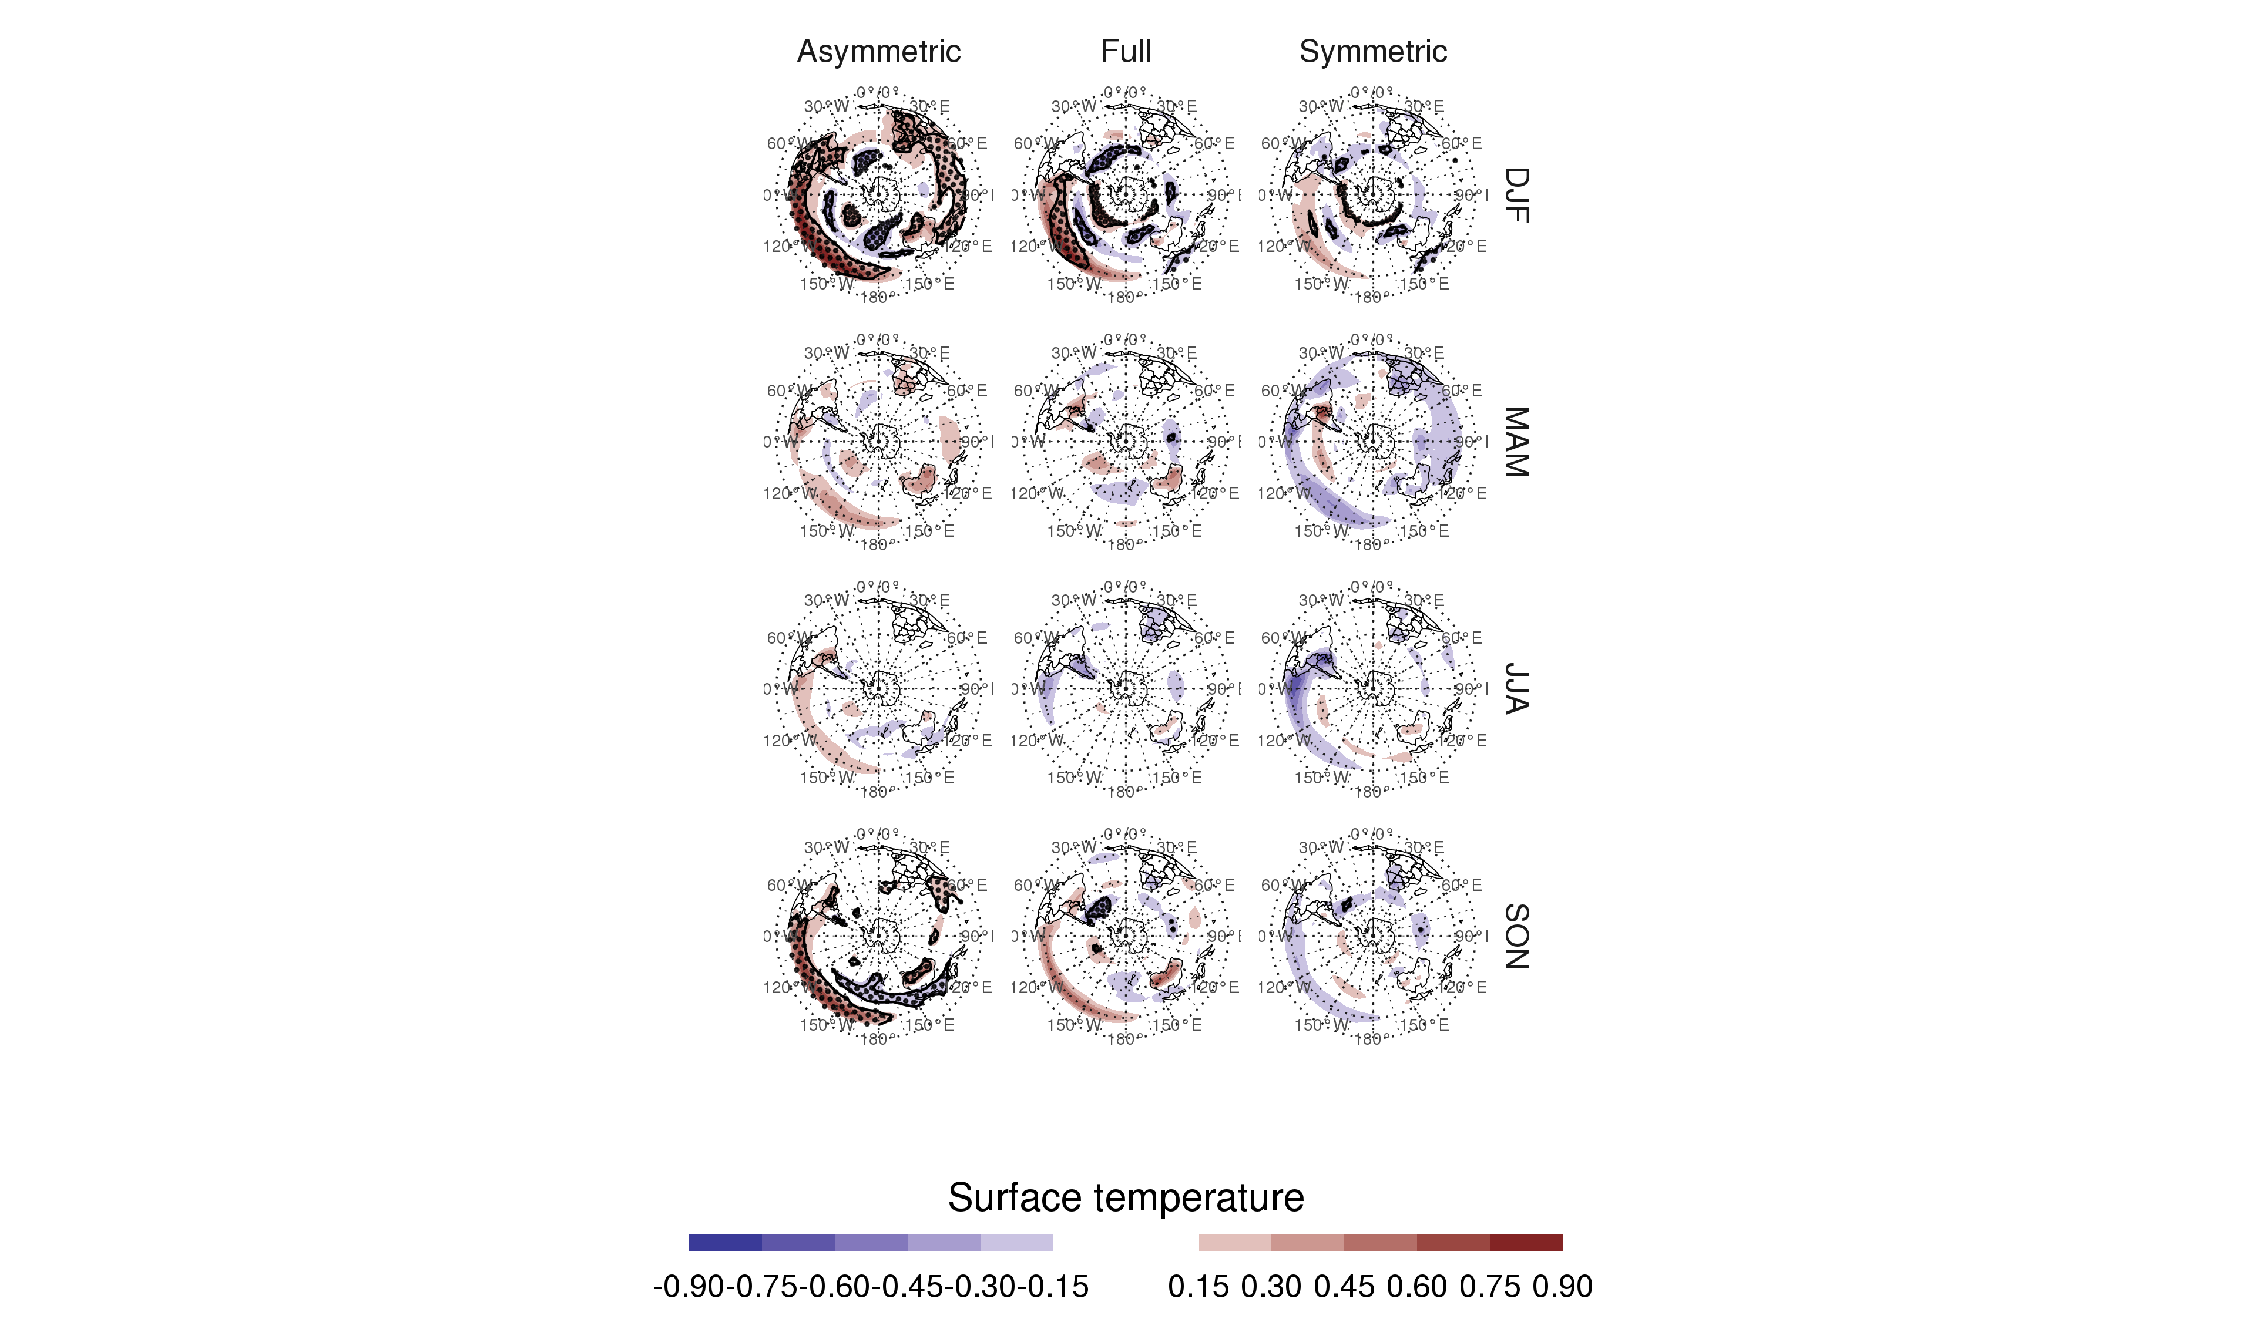
Regression pattern of surface temperature with Asymmetric and Symmetric SAM. P-values smaller than 0.05 (controlling for Flase Detection Rate) as hatched areas.

Slide 21
Discussion

Slide 22
Conclusion

Slide 23
Acknowledgements

Slide 24
References

Slide 25
Colophon
This report was generated on 2020-07-03 17:58:31 using the following computational environment and dependencies:
#> ─ Session info ─────────────────────────────────────────────────────────────── #> setting value #> version R version 3.5.3 (2019-03-11) #> os Debian GNU/Linux 9 (stretch) #> system x86_64, linux-gnu #> ui X11 #> language (EN) #> collate en_US.UTF-8 #> ctype en_US.UTF-8 #> tz America/Argentina/Buenos_Aires #> date 2020-07-03 #> #> ─ Packages ─────────────────────────────────────────────────────────────────── #> package * version date lib source #> ash 1.0-15 2015-09-01 [1] CRAN (R 3.5.3) #> assertthat 0.2.1 2019-03-21 [1] CRAN (R 3.5.3) #> asymsam * 0.0.0.9000 2020-07-03 [1] local #> backports 1.1.8 2020-06-17 [1] CRAN (R 3.5.3) #> bitops 1.0-6 2013-08-17 [1] CRAN (R 3.5.3) #> boot 1.3-20 2017-07-30 [4] CRAN (R 3.5.1) #> broom 0.5.5 2020-02-29 [1] CRAN (R 3.5.3) #> callr 3.4.3 2020-03-28 [1] CRAN (R 3.5.3) #> checkmate 2.0.0 2020-02-06 [1] CRAN (R 3.5.3) #> class 7.3-15 2019-01-01 [4] CRAN (R 3.5.3) #> classInt 0.4-2 2019-10-17 [1] CRAN (R 3.5.3) #> cli 2.0.2 2020-02-28 [1] CRAN (R 3.5.3) #> clisymbols 1.2.0 2017-05-21 [1] CRAN (R 3.5.3) #> codetools 0.2-16 2018-12-24 [4] CRAN (R 3.5.3) #> colorspace 1.4-1 2019-03-18 [1] CRAN (R 3.5.3) #> crayon 1.3.4 2017-09-16 [1] CRAN (R 3.5.3) #> crul 0.9.0 2019-11-06 [1] CRAN (R 3.5.3) #> curl 4.3 2019-12-02 [1] CRAN (R 3.5.3) #> data.table * 1.12.8 2019-12-09 [1] CRAN (R 3.5.3) #> DBI 1.1.0 2019-12-15 [1] CRAN (R 3.5.3) #> desc 1.2.0 2018-05-01 [1] CRAN (R 3.5.3) #> devtools 2.3.0 2020-04-10 [1] CRAN (R 3.5.3) #> digest 0.6.25 2020-02-23 [1] CRAN (R 3.5.3) #> dplyr 1.0.0 2020-05-29 [1] CRAN (R 3.5.3) #> e1071 1.7-3 2019-11-26 [1] CRAN (R 3.5.3) #> ellipsis 0.3.1 2020-05-15 [1] CRAN (R 3.5.3) #> evaluate 0.14 2019-05-28 [1] CRAN (R 3.5.3) #> extrafont 0.17 2014-12-08 [1] CRAN (R 3.5.3) #> extrafontdb 1.0 2012-06-11 [1] CRAN (R 3.5.3) #> fansi 0.4.1 2020-01-08 [1] CRAN (R 3.5.3) #> farver 2.0.3 2020-01-16 [1] CRAN (R 3.5.3) #> foreign 0.8-71 2018-07-20 [4] CRAN (R 3.5.2) #> fs 1.4.1 2020-04-04 [1] CRAN (R 3.5.3) #> generics 0.0.2 2018-11-29 [1] CRAN (R 3.5.3) #> geojson 0.3.2 2019-01-31 [1] CRAN (R 3.5.3) #> geojsonio 0.9.0 2020-02-13 [1] CRAN (R 3.5.3) #> geojsonlint 0.4.0 2020-02-13 [1] CRAN (R 3.5.3) #> ggalt 0.6.2 2020-06-08 [1] Github (eliocamp/ggalt@8d9e728) #> ggh4x * 0.1.1 2020-03-24 [1] Github (teunbrand/ggh4x@1a547cc) #> ggperiodic * 1.0.0 2019-03-12 [1] CRAN (R 3.5.3) #> ggplot2 * 3.3.2.9000 2020-07-03 [1] Github (eliocamp/ggplot2@f12f344) #> glue 1.4.1 2020-05-13 [1] CRAN (R 3.5.3) #> gtable 0.3.0 2019-03-25 [1] CRAN (R 3.5.3) #> here 0.1 2017-05-28 [1] CRAN (R 3.5.3) #> highr 0.8 2019-03-20 [1] CRAN (R 3.5.3) #> hms 0.5.3 2020-01-08 [1] CRAN (R 3.5.3) #> htmltools 0.5.0 2020-06-16 [1] CRAN (R 3.5.3) #> httpcode 0.3.0 2020-04-10 [1] CRAN (R 3.5.3) #> janeaustenr 0.1.5 2017-06-10 [1] CRAN (R 3.5.3) #> jqr 1.1.0 2018-10-22 [1] CRAN (R 3.5.3) #> jsonlite 1.6.1 2020-02-02 [1] CRAN (R 3.5.3) #> jsonvalidate 1.1.0 2019-06-25 [1] CRAN (R 3.5.3) #> KernSmooth 2.23-15 2015-06-29 [4] CRAN (R 3.5.2) #> knitr 1.29 2020-06-23 [1] CRAN (R 3.5.3) #> labeling 0.3 2014-08-23 [1] CRAN (R 3.5.3) #> lattice 0.20-38 2018-11-04 [4] CRAN (R 3.5.2) #> lazyeval 0.2.2 2019-03-15 [1] CRAN (R 3.5.3) #> lifecycle 0.2.0 2020-03-06 [1] CRAN (R 3.5.3) #> lubridate 1.7.9 2020-06-08 [1] CRAN (R 3.5.3) #> magrittr * 1.5 2014-11-22 [1] CRAN (R 3.5.3) #> maps 3.3.0 2018-04-03 [1] CRAN (R 3.5.3) #> maptools 0.9-9 2019-12-01 [1] CRAN (R 3.5.3) #> MASS 7.3-51.1 2018-11-01 [4] CRAN (R 3.5.2) #> Matrix 1.2-16 2019-03-08 [4] CRAN (R 3.5.3) #> memoise 1.1.0 2017-04-21 [1] CRAN (R 3.5.3) #> metR * 0.8.9000 2020-07-03 [1] Github (eliocamp/metR@ac62e39) #> munsell 0.5.0 2018-06-12 [1] CRAN (R 3.5.3) #> ncdf4 1.17 2019-10-23 [1] CRAN (R 3.5.3) #> nlme 3.1-137 2018-04-07 [4] CRAN (R 3.5.2) #> pillar 1.4.4 2020-05-05 [1] CRAN (R 3.5.3) #> pkgbuild 1.0.8 2020-05-07 [1] CRAN (R 3.5.3) #> pkgconfig 2.0.3 2019-09-22 [1] CRAN (R 3.5.3) #> pkgload 1.1.0 2020-05-29 [1] CRAN (R 3.5.3) #> plyr 1.8.6 2020-03-03 [1] CRAN (R 3.5.3) #> prettyunits 1.1.1 2020-01-24 [1] CRAN (R 3.5.3) #> processx 3.4.2 2020-02-09 [1] CRAN (R 3.5.3) #> proj4 1.0-10 2020-03-02 [1] CRAN (R 3.5.3) #> prompt 1.0.0 2020-01-17 [1] Github (gaborcsardi/prompt@b332c42) #> ps 1.3.3 2020-05-08 [1] CRAN (R 3.5.3) #> purrr 0.3.4 2020-04-17 [1] CRAN (R 3.5.3) #> R6 2.4.1 2019-11-12 [1] CRAN (R 3.5.3) #> RColorBrewer 1.1-2 2014-12-07 [1] CRAN (R 3.5.3) #> Rcpp 1.0.4.6 2020-04-09 [1] CRAN (R 3.5.3) #> RCurl 1.98-1.2 2020-04-18 [1] CRAN (R 3.5.3) #> readr 1.3.1 2018-12-21 [1] CRAN (R 3.5.3) #> remotes 2.1.1 2020-02-15 [1] CRAN (R 3.5.3) #> reshape2 1.4.3 2017-12-11 [1] CRAN (R 3.5.3) #> rgdal 1.4-8 2019-11-27 [1] CRAN (R 3.5.3) #> rgeos 0.5-2 2019-10-03 [1] CRAN (R 3.5.3) #> rlang 0.4.6 2020-05-02 [1] CRAN (R 3.5.3) #> rmapshaper 0.4.3 2020-01-28 [1] CRAN (R 3.5.3) #> rmarkdown 2.3 2020-06-18 [1] CRAN (R 3.5.3) #> rprojroot 1.3-2 2018-01-03 [1] CRAN (R 3.5.3) #> rstudioapi 0.11 2020-02-07 [1] CRAN (R 3.5.3) #> Rttf2pt1 1.3.8 2020-01-10 [1] CRAN (R 3.5.3) #> scales 1.1.1 2020-05-11 [1] CRAN (R 3.5.3) #> sessioninfo 1.1.1 2018-11-05 [1] CRAN (R 3.5.3) #> sf 0.9-0 2020-03-24 [1] CRAN (R 3.5.3) #> SnowballC 0.6.0 2019-01-15 [1] CRAN (R 3.5.3) #> sp 1.4-1 2020-02-28 [1] CRAN (R 3.5.3) #> sticky 0.5.6.1 2020-03-16 [1] CRAN (R 3.5.3) #> stringi 1.4.6 2020-02-17 [1] CRAN (R 3.5.3) #> stringr 1.4.0 2019-02-10 [1] CRAN (R 3.5.3) #> testthat 2.3.2 2020-03-02 [1] CRAN (R 3.5.3) #> tibble 3.0.1 2020-04-20 [1] CRAN (R 3.5.3) #> tidyr 1.1.0 2020-05-20 [1] CRAN (R 3.5.3) #> tidyselect 1.1.0 2020-05-11 [1] CRAN (R 3.5.3) #> tidytext 0.2.3 2020-03-04 [1] CRAN (R 3.5.3) #> tokenizers 0.2.1 2018-03-29 [1] CRAN (R 3.5.3) #> udunits2 0.13 2016-11-17 [1] CRAN (R 3.5.3) #> units 0.6-6 2020-03-16 [1] CRAN (R 3.5.3) #> usethis 1.6.1 2020-04-29 [1] CRAN (R 3.5.3) #> V8 3.0.2 2020-03-14 [1] CRAN (R 3.5.3) #> vctrs 0.3.1 2020-06-05 [1] CRAN (R 3.5.3) #> viridisLite 0.3.0 2018-02-01 [1] CRAN (R 3.5.3) #> widyr 0.1.2 2019-09-09 [1] CRAN (R 3.5.3) #> withr 2.2.0 2020-04-20 [1] CRAN (R 3.5.3) #> xfun 0.15 2020-06-21 [1] CRAN (R 3.5.3) #> yaml 2.2.1 2020-02-01 [1] CRAN (R 3.5.3) #> #> [1] /home/elio.campitelli/R/x86_64-pc-linux-gnu-library/3.5 #> [2] /usr/local/lib/R/site-library #> [3] /usr/lib/R/site-library #> [4] /usr/lib/R/library
The current Git commit details are:
#> Local: master /home/elio.campitelli/asymsam #> Remote: master @ origin (https://github.com/eliocamp/asymsam.git) #> Head: [ba6263d] 2020-06-30: seasonal pp regression

